Slide 1
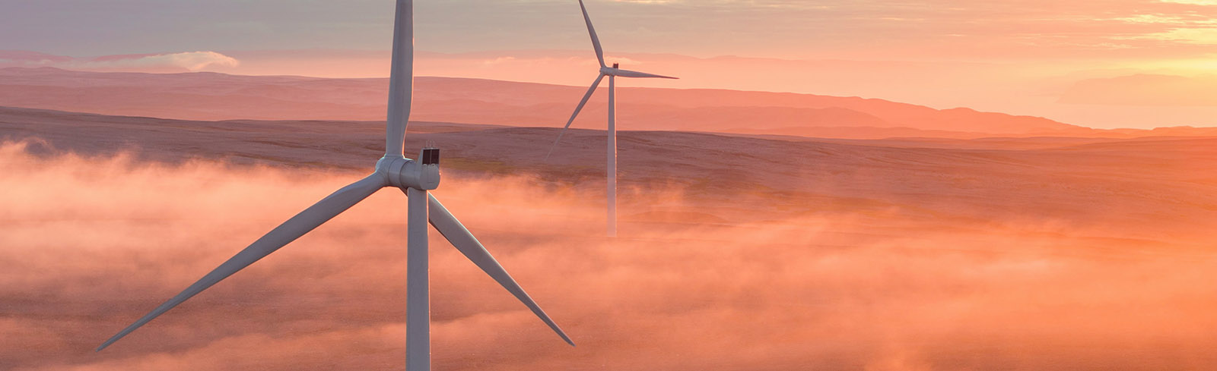
Siemens Gamesa Renewable Energy The best technology for your wind projects in Brazil
30 August 2017
© Siemens Gamesa Renewable Energy

Slide 2
Content
Company Profile
Technological Solutions for Brazil
G114 2.0/2.1MW
G114 2.5/2.625MW
G132 3.3./3.465MW

Slide 3
1. Company Profile

Slide 4
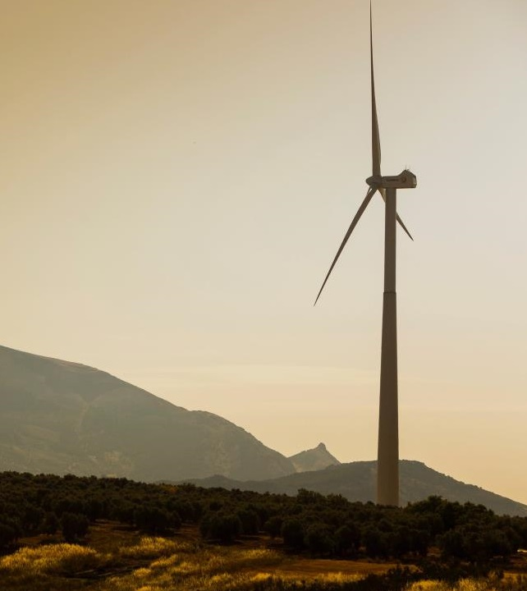
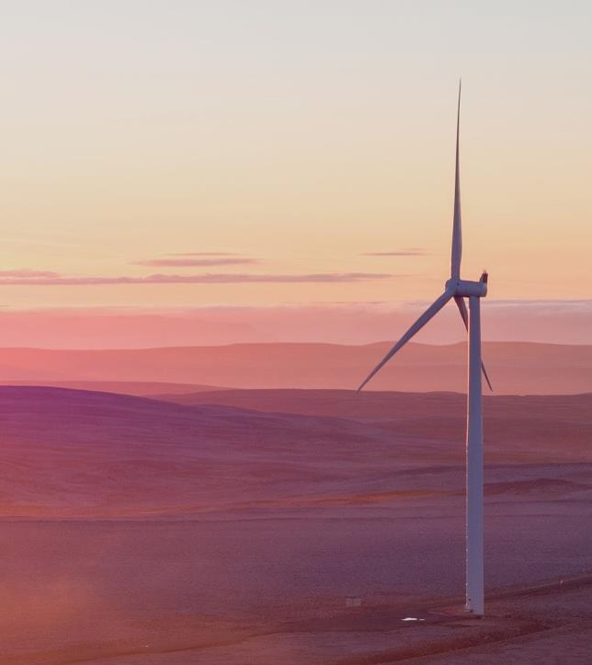
Gamesa and
Siemens Wind Power
join forces

Slide 5

What does this mean for our customers and suppliers?
Stronger business partner
New opportunities for collaboration and partnership
The broadest product portfolio in the market
World class technology to further lower energy costs

Slide 6
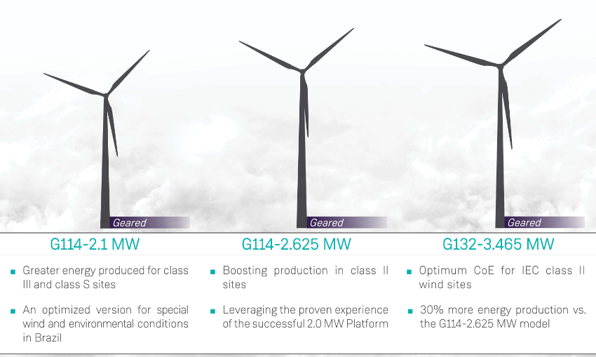
Brazil Wind Power 2017
A broad and versatile Product Portfolio

Slide 7

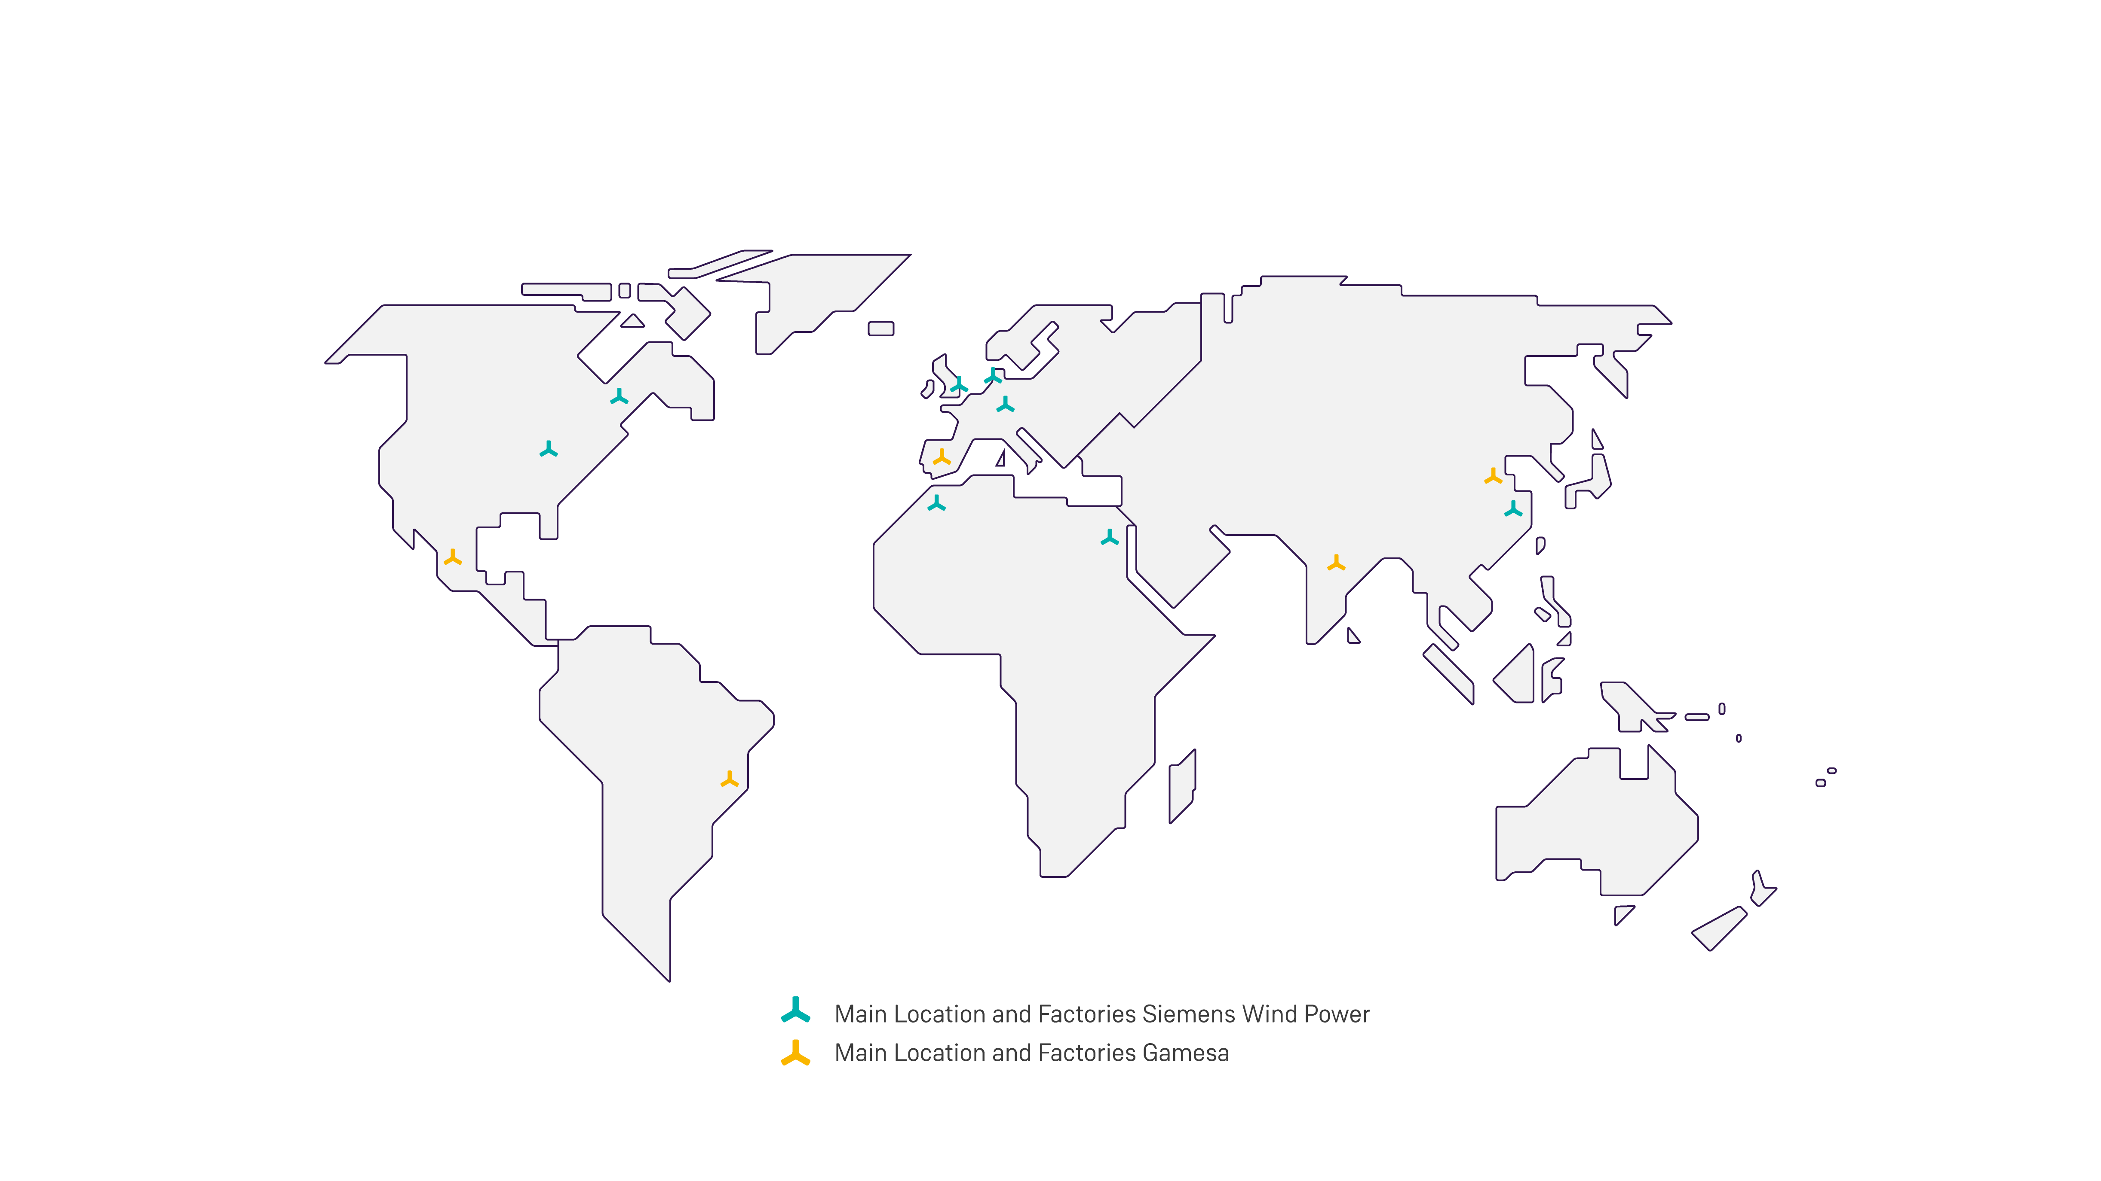
Brazil Wind Power 2017
Products and technology in 90+ countries
Installed capacity 75 GW

Slide 8
2. Technological Solutions for Brazil

Slide 9
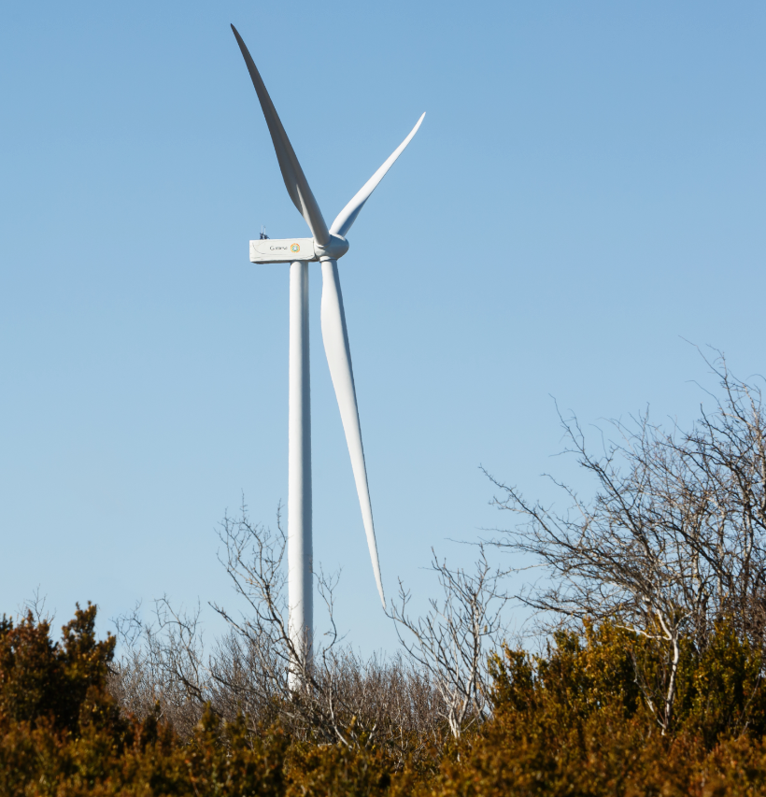
G114-2.0/2.1 MW
© Siemens Gamesa Renewable Energy

Slide 10
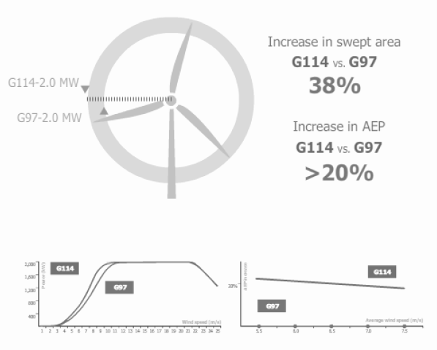
Brazil Wind Power 2017
The new benchmark in the market
G114-2.0 MW
The best capacity factor in the market.
Optimized for low and medium wind sites.
Proven technologies.
2,211 MW installed and over 4,770 MW in firm orders of G114-2.0 and 2.1 MW.
Nominal power increase to 2.1 MW available.
© Siemens Gamesa Renewable Energy

Slide 11
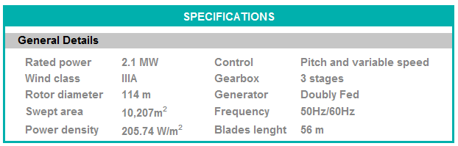
G114-2.0/2.1 MW
One of the most successful platforms in the market:
Availability levels exceeding 98%
13 years in the market and 12,959 turbines installed in 39 countries
Towers portfolio:
T68, T80, T93, T125 (steel)
T120 (concrete)
© Siemens Gamesa Renewable Energy

Slide 12
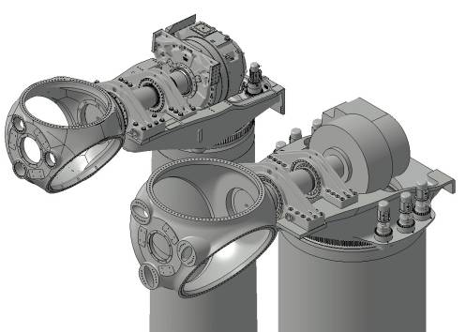
Brazil Wind Power 2017
Comparison with – G97-2.0 MW
More efficient mechanical structure to allocate larger rotors
Increased capacity for gearbox and hydraulic/pitch system
Gearbox ratio adapted to maximize performance (optimum trade-off AEP vs. noise)
Key components of drive train upscaled
Same electrical components
G97
G114
Prototype G126-2.5 MW T80 50Hz Alaiz (Spain)
© Siemens Gamesa Renewable Energy

Slide 13
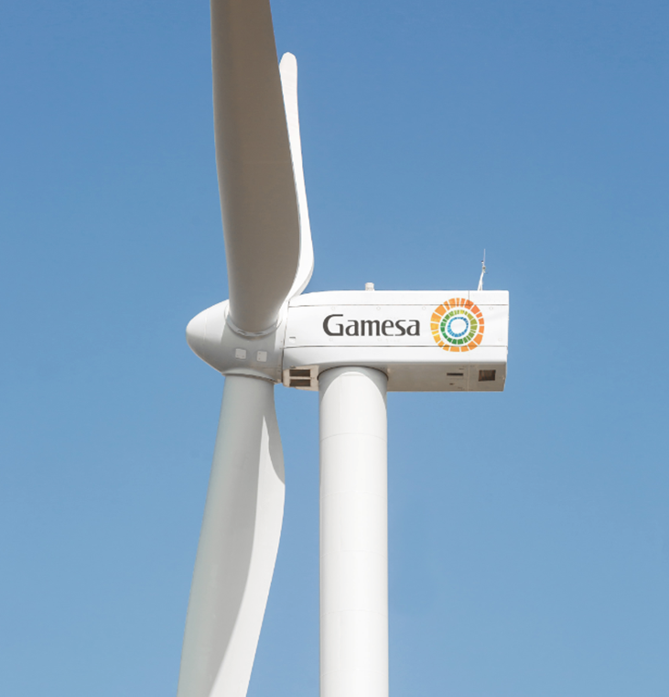
G114-2.5/2.625 MW
© Siemens Gamesa Renewable Energy

Slide 14
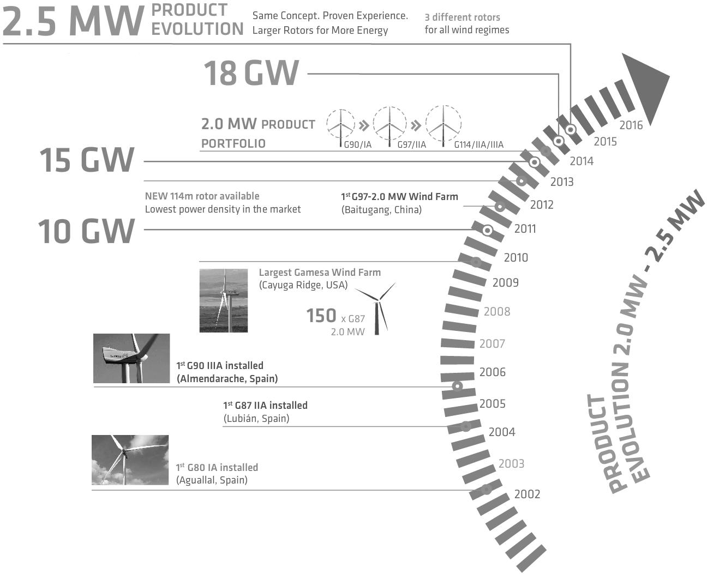
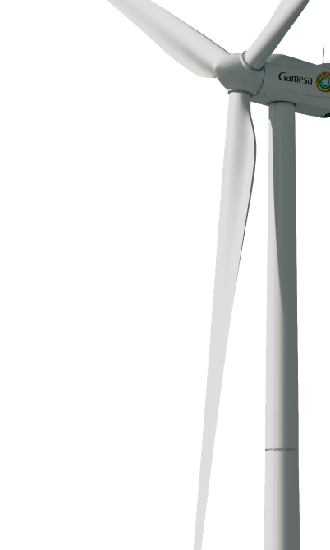
Brazil Wind Power 2017
Leveraging the proven experience of the 2.0 MW Platform
G114-2.5 MW
Guaranteed reliability backed by the proven experience of the 2.0 MW platform.
G114-2.5 MW IIA: fully validated and certified, in serial production with over 900 MW in firm orders (G114-2.5 and G114-2.625 MW) @Q4 2016.
More than 900 MW already signed @4Q 2016
Nominal power increase to 2.625MW available.
© Siemens Gamesa Renewable Energy

Slide 15

G114-2.5/2.625 MW
Product overview
Boosting production in medium wind sites
Higher nominal power: roughly 29% more energy than G97-2.0 MW IIA in Class II sites.
Profitability: 10% CoE improvement vs. G97-2.0 MW IIA
It will coexist with G97-2.0 MW and G114-2.0 MW – they will target different market segments
Towers portfolio:
T68, T80, T93, T125 (steel)
T120 (concrete)
© Siemens Gamesa Renewable Energy

Slide 16
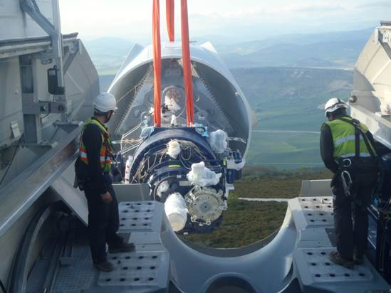
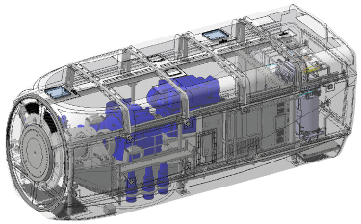
Brazil Wind Power 2017
Comparison with – G114-2.0 MW
Blade:
Same aerodynamic design and external surface (G114-2.0 MW blade design already contemplated the upscaling to 2.5 MW)
Same moulds
Reduced design risks – most of blade validation and testing during the G114-2.0 MW project
New 2.5 MW electrical system:
Same concept (DFIM), nacelle topology and control strategy
New upscaled converter, generator and transformers
Mechanical system:
Reinforcements to blade bearings, torque arms and main frame
Rest of components are the same
© Siemens Gamesa Renewable Energy

Slide 17
G132-3.3/3.465 MW
© Siemens Gamesa Renewable Energy

Slide 18
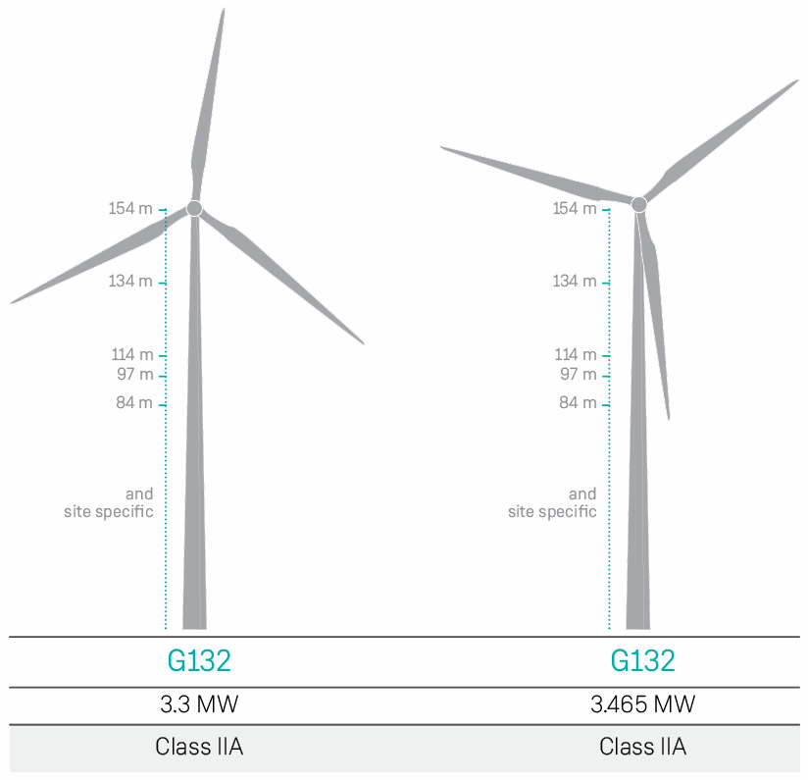
Brazil Wind Power 2017
One of the largest rotors in the market
G132-3.3 MW
Class IIA and high nominal power:
50% more energy production vs. G114-2.0 MW in Class II
30% more energy production vs. G114-2.5 MW in Class II
Top class reliability and low technological risk:
Same proven technologies adopted in the 2.0 MW and 2.5 MW platforms
64.5 m blade based on the fully validated design of the G132-5.0 MW IIA blade
Nominal power increase to 3.465 MW available.

Slide 19
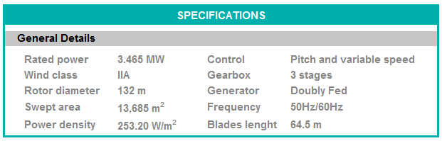
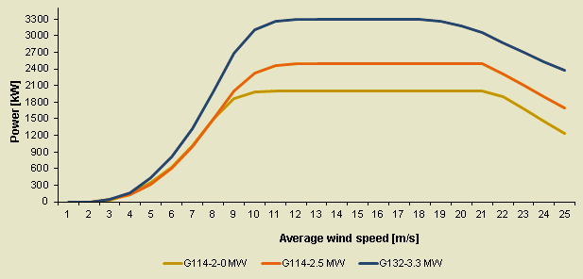
G132-3.3/3.465 MW
Brazil Wind Power 2017
Optimum CoE for sites with medium winds:
First turbine model in the new generation geared 3.3 MW Platform
It coexists with other turbine models in the product portfolio designed for medium winds, targeting mainly markets requiring solutions with high nominal power
Towers portfolio:
T84, T97, T114, T134, T154 (steel)
T134 hybrid solution available (cast-in-place concrete + steel concrete)
© Siemens Gamesa Renewable Energy

Slide 20
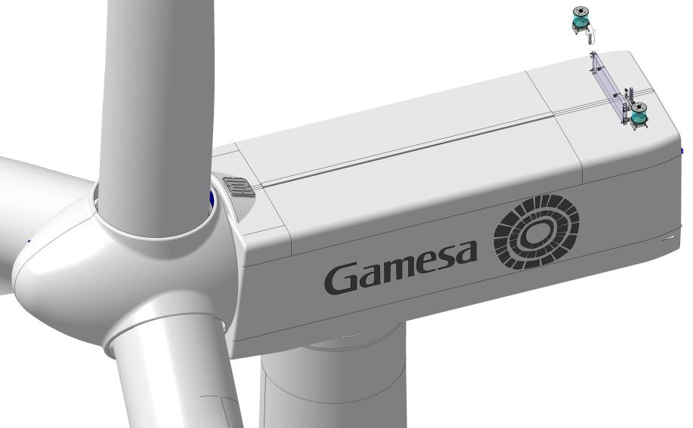
Technological highlights: Nacelle and Hub
Brazil Wind Power 2017
NACELLE 4.2m x 4.1m x 12.5m (w x h x l)
HUB (same technology G114 2.5MW)
© Siemens Gamesa Renewable Energy

Slide 21
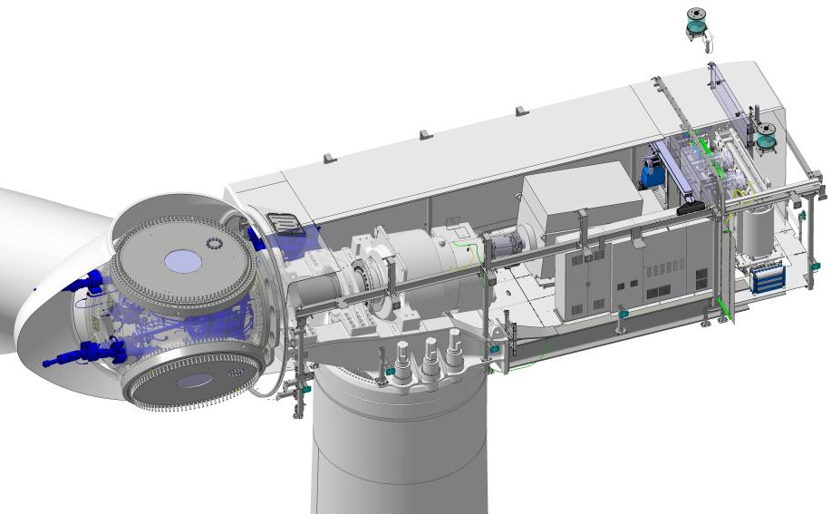
Technological highlights: Nacelle and Hub
Brazil Wind Power 2017
Pitch System
© Siemens Gamesa Renewable Energy

Slide 22
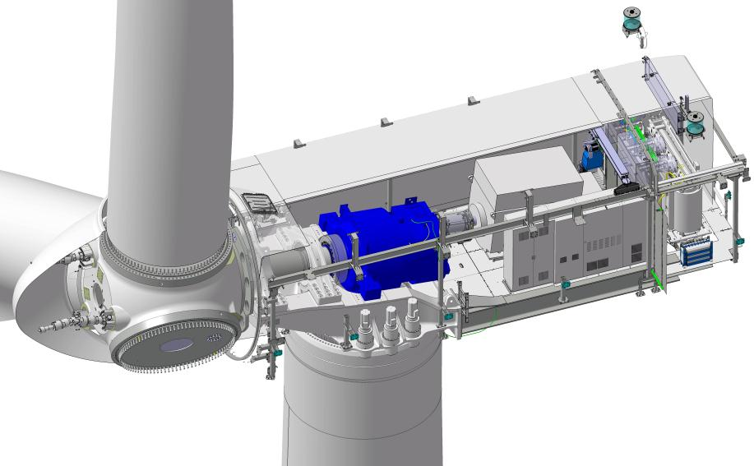
Technological highlights: Nacelle and Hub
Brazil Wind Power 2017
Gearbox
© Siemens Gamesa Renewable Energy

Slide 23
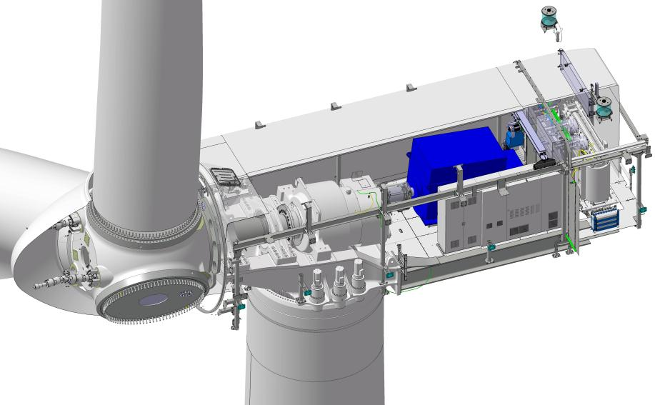
Technological highlights: Nacelle and Hub
Brazil Wind Power 2017
Generator
© Siemens Gamesa Renewable Energy

Slide 24
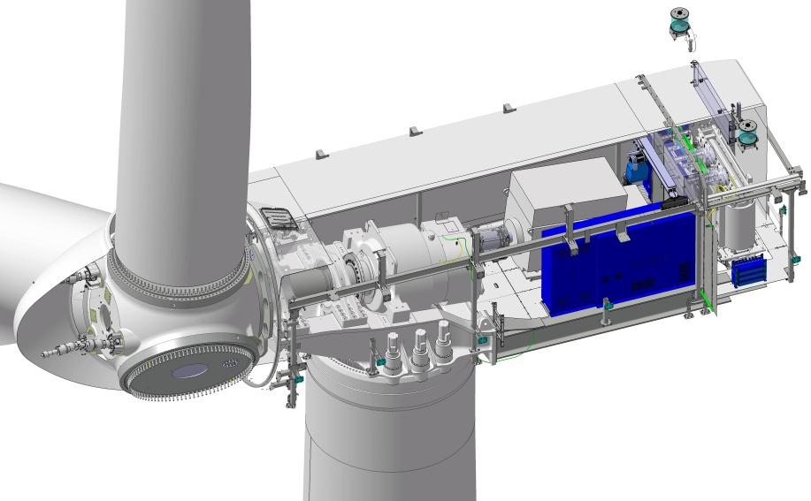
Technological highlights: Nacelle and Hub
Brazil Wind Power 2017
Converter
© Siemens Gamesa Renewable Energy

Slide 25
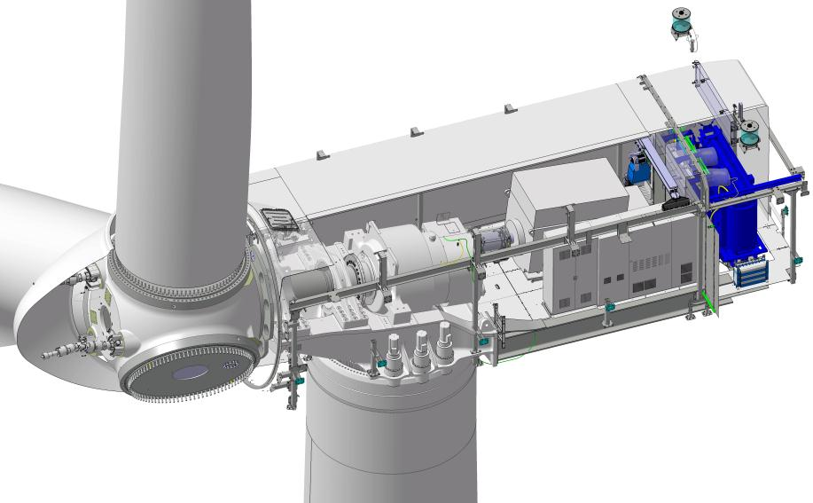
Technological highlights: Nacelle and Hub
Brazil Wind Power 2017
Transformer
© Siemens Gamesa Renewable Energy

Slide 26
Brazil Wind Power 2017
Prototype – G132-3.465 MW
First prototype G132-3.465 MW IIA was erected in Alaiz (Spain) during September 2016:
Power curve measurement completed:
Measured AEP in line with theoretical values
Loads measurement completed
Prototype G132-3.3 MW T114, Alaiz (Spain)
© Siemens Gamesa Renewable Energy

Slide 27
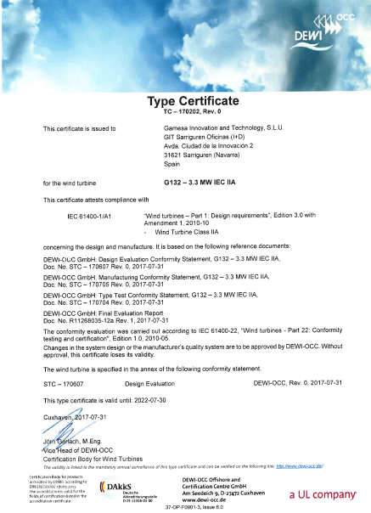
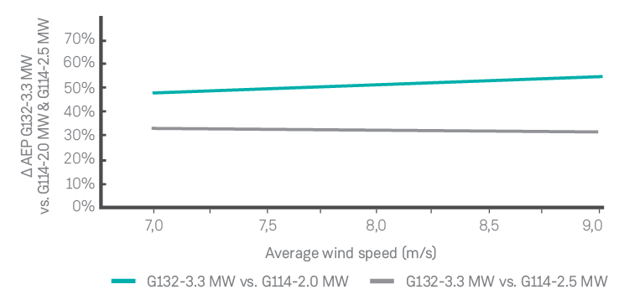
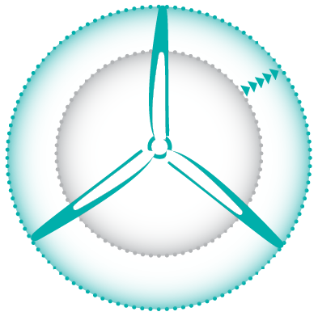
Brazil Wind Power 2017
The most profitable product in its segment
Swept area increase
AEP increase
+34%
G114
G132
Key project milestones
4Q2015
Official market launch
2Q2016
Design Certificate
3Q2016
First prototype
2Q2017
Type Certificate and Serial Production
Available in Serial Production from Q2 2017
© Siemens Gamesa Renewable Energy

Slide 28
Thank you.
Contact
Warwick David Heaney
Technology Director
Phone: +55 (11) 3096-4444
Ext.: 33278
wdheaney@gamesacorp.com
Aug 30th 2017

